Slide 1


GESTURE DRIVEN UNMANNED VEHICLE
Mid-Review 3
Major Project
Project ID: CS8
AY 2021-25
GITAM (Deemed-to-be) University
Project Team:
Nunna Karthikeyan -BU21EECE0100478
Sandhya Kuram - BU21EECE0100165
Kumpati Rakesh – BU21EECE0100506
Department of Electrical Electronics and Communication Engineering
Project Mentor:
DR.K.KOSHY GEORGE
Project In-charge:
PANKAJ KANDHWAY
www.gitam.edu

Slide 2
✅ Objective of the Project:
To develop a gesture-controlled unmanned vehicle that moves in different directions based on hand gestures detected via a camera.
To implement a wireless communication system between the gesture recognition system and the vehicle.
✅ Key Features:
Real-time hand gesture recognition.
Wireless control using NRF24L01 transceivers.
Vehicle responds to predefined gestures (F, B, L, R, S).
Uses Arduino UNO and ESP32 for efficient system processing.
Objective and Goals
Objective

Slide 3
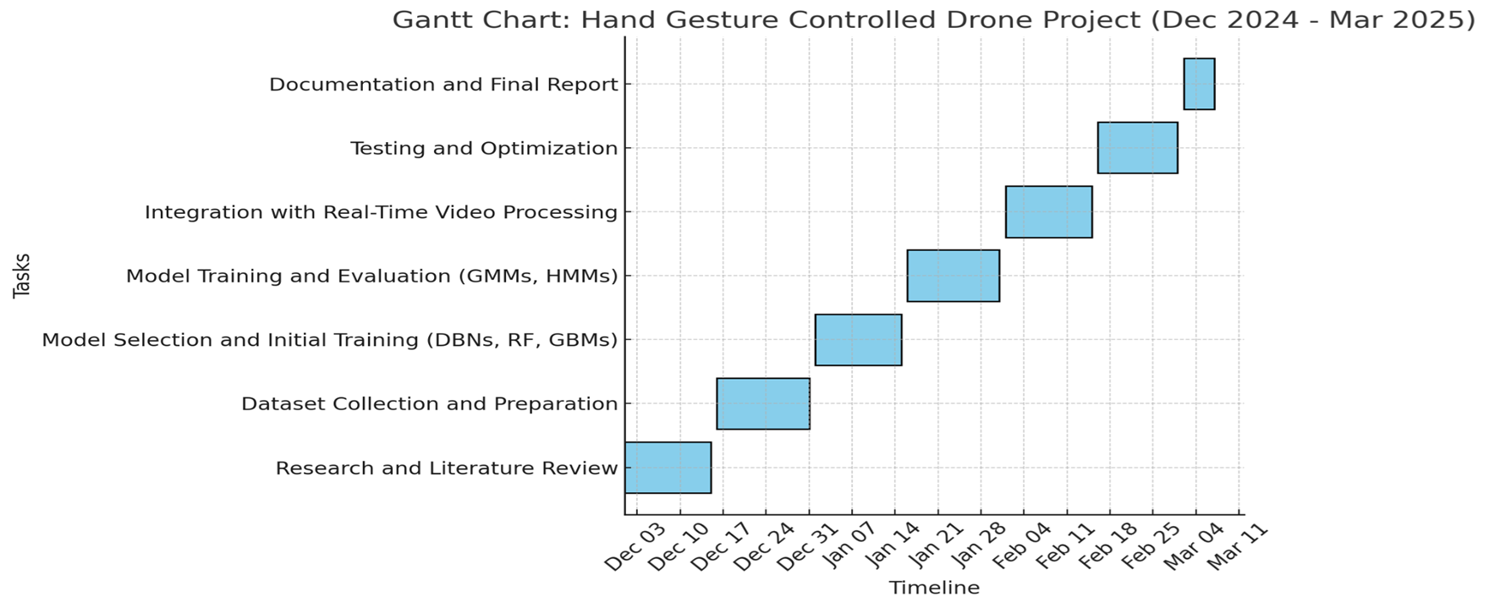
GANTT CHART

Slide 4
GOALS
Primary Goals
Implement real-time gesture recognition to detect predefined hand movements.
Use NRF24L01 for wireless data transmission between ESP32 (Transmitter) and Arduino UNO (Receiver).
Ensure precise motor control for vehicle movement.
Minimize latency in data transmission and vehicle response.
Secondary Goals (Future Enhancements)
Integrate machine learning models to improve gesture recognition.
Upgrade to advanced communication protocols (LoRa/Zigbee).
Implement obstacle detection using ultrasonic sensors.

Slide 5
How It Works:
1. A camera detects hand gestures and processes them using OpenCV (Future Scope). 2. The recognized gesture is sent to ESP32, which transmits the command (F, B, L, R, S) via NRF24L01. 3. Arduino UNO (Receiver) receives the signal and controls the motor driver (TB6612FNG) to move the vehicle accordingly. 4. The vehicle executes movement commands and stops upon receiving 'S'.
Project Plan (Clearly mention milestone for objectives under each reviews)

Slide 6
Literature Survey (Improved post minor project)
Key Publications
Gesture-Based Control Systems
1.Hand Gesture Recognition Using OpenCV & ML
Researchers have successfully used OpenCV and Deep Learning to classify hand gestures.
Methods such as CNN (Convolutional Neural Networks) improve gesture detection accuracy.
Reference: XYZ et al., "Real-Time Hand Gesture Recognition for Smart Devices," IEEE, 2022.
2. Embedded System-Based Gesture Control for Robotics
Arduino and Raspberry Pi-based systems have been implemented for gesture-controlled robotic arms.
Reference: "Gesture-Based Robotic Control using Arduino and Image Processing," IJRET, 2021.
Key Resources – Whitepaper| Application Notes | Datasheet| Others
Comparison of Wireless Modules: NRF24L01 vs. LoRa vs. Zigbee
NRF24L01 is ideal for short-range, low-latency applications like gesture-controlled vehicles.
LoRa provides better long-range capabilities but at a lower data rate.
Reference: "Comparative Study of Wireless Modules for IoT Applications," ScienceDirect, 2019.
Existing Implementations – Products| Opensource| GitHub etc
Gesture-Based Navigation in Unmanned Vehicles
Gesture-controlled systems are being integrated into semi-autonomous delivery robots.
The use of IMU sensors and computer vision improves precision.
Reference: "Gesture-Based Human-Machine Interaction in Autonomous Systems," IEEE, 2023.

Slide 7
Hardware Components
Microcontrollers
ESP32: Processes and transmits gesture commands. Arduino UNO: Receives commands and controls the motor driver.
Communication Module
NRF24L01 (Wireless Transceiver): Sends data between transmitter and receiver.
Motor Driver & Motors
TB6612FNG Motor Driver: Controls the motors based on received commands. BO Motors (4x): Provide movement to the vehicle.
Power Supply
18650 Li-ion Batteries: Powers the vehicle. LD33CV Voltage Regulator: Provides stable 3.3V to NRF24L01.
Additional Components
Capacitors (10µF & 100µF): Prevents power fluctuations. Wires & Connectors: For proper wiring.

Slide 8
Software Components
Programming Languages
C++ (for Arduino/ESP32 Programming in Arduino IDE) Python (For Gesture Recognition - Future Scope)
Software Used
Arduino IDE: Writing and uploading microcontroller code. OpenCV (Future Scope): Gesture recognition. nRF24L01 Library: Wireless communication setup.

Slide 9
System Architecture
Gesture Recognition Stage
The camera captures hand gestures.
Future scope: Machine Learning model to classify gestures.
Wireless Transmission
ESP32 sends commands (F, B, L, R, S) via NRF24L01.
Arduino UNO receives the signal via NRF24L01.
Motor Control & Vehicle Movement
Arduino UNO activates TB6612FNG motor driver.
The vehicle moves in the required direction.

Slide 10
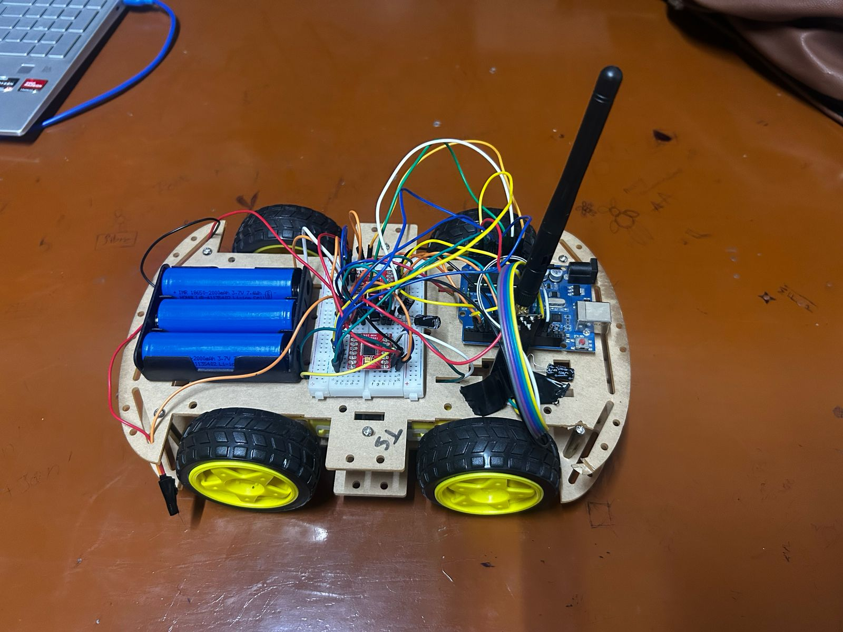
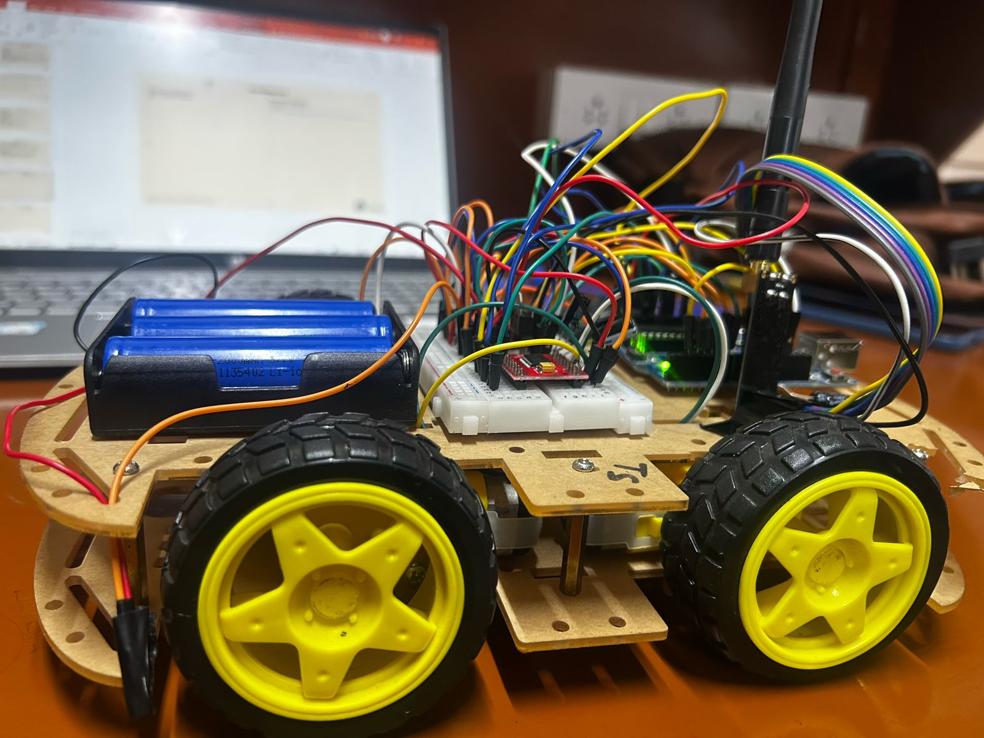
UNMANNED VEHICLE PROTOTYPE

Slide 11
Use Cases & Testing
1. NRF24L01 Communication Test
Ensured successful transmission of data (F, B, L, R, S) from ESP32 to Arduino UNO.
Used Serial Monitor logs to confirm successful reception.
2. Individual Motor Testing
Tested each BO motor individually by manually sending commands.
Ensured smooth forward, backward, left, and right motion.
3. Integration Testing
Connected all hardware components (ESP32, NRF24L01, Arduino, Motor Driver).
Verified correct movement corresponding to received commands.
4. Stability & Power Supply Testing
Identified NRF24L01 power failures due to fluctuations.
Fixed by adding capacitors (10µF & 100µF) to VCC-GND.
5. Final Real-World Testing
Tested vehicle movement at different distances (1m, 5m, 10m, etc.).
Measured transmission range and latency.
Ensured the vehicle correctly stops on 'S' command.
Use Cases
1.Disaster Management & Rescue Operations
Can be deployed in hazardous environments where human access is risky.
Gesture control allows remote operation in unstable terrains.
2.Military & Defense
Used in unmanned reconnaissance vehicles to navigate battlefields safely.
Reduces human exposure to dangerous zones.
3.Industrial Automation
Can be used in factories and warehouses to move goods using simple hand gestures.
Improves efficiency in automated logistic systems.
4.Healthcare & Assistance for Differently Abled Individuals
Helps physically impaired users control wheelchairs or robotic assistants via gestures.
Can be integrated with assistive robotic systems.
5.Smart Transportation Systems
Can be used in autonomous delivery robots.
Gesture-based navigation can improve user interaction with smart vehicles.
Test Cases

Slide 12
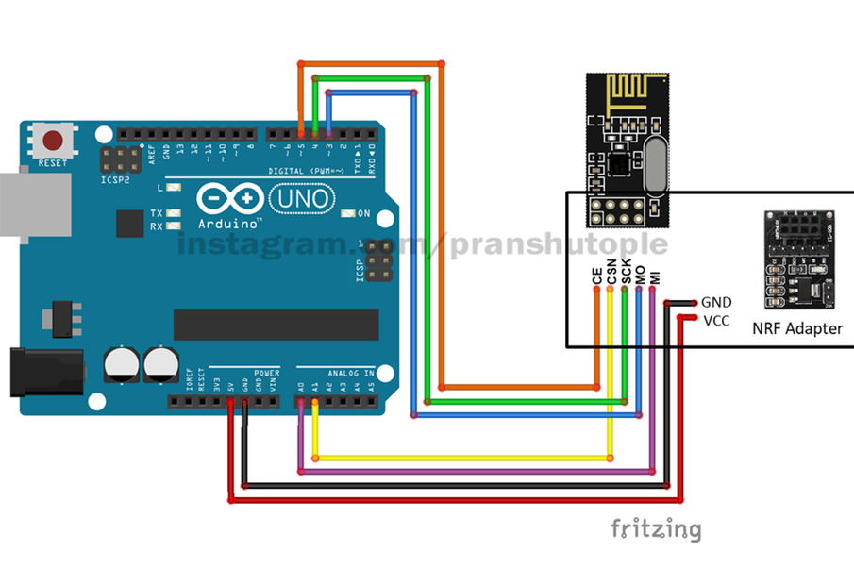
STRUCTURAL DIAGRAM OF UNO TO NRF24LO1

Slide 13
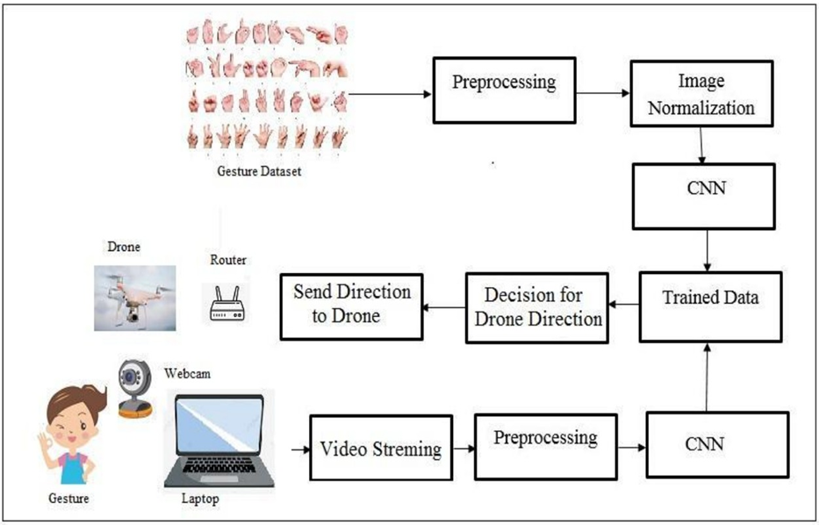
BEHAVIOURAL DIAGRAM OF THE PROJECT

Slide 14
Implementation Process
1️⃣ Hardware Setup
Assembled ESP32 (Transmitter) & Arduino UNO (Receiver).
Connected NRF24L01 modules for wireless communication.
Integrated TB6612FNG Motor Driver and tested motor connections.
2️⃣ Software Development
Programmed ESP32 to send movement commands (F, B, L, R, S).
Programmed Arduino UNO to receive and process commands.
Used Arduino IDE for coding & debugging.
3️⃣ Wireless Communication Testing
Verified NRF24L01 transmission & reception using Serial Monitor.
Ensured commands were correctly received at different distances.
Implementation and Results – Iteration 1

Slide 15
Results – Iteration 1
Transmission Success Rate: 90% within a 5m range. Vehicle responds correctly to: F, B, L, R, S commands. Power Optimization: Stable voltage achieved with capacitors (10µF & 100µF). Latency: Response time ~0.2s after command transmission.
Implementation and Results
Iteration : Results + Validation against the use cases and test cases

Slide 16
Implementation and Results – Iteration 2
Enhancements Over Iteration 1
Improved Wireless Communication
Upgraded to NRF24L01+ PA/LNA module for increased range & stability.
Optimized transmission settings (RF24_PA_HIGH, RF24_250KBPS).
Motor Response Optimization
Refined motor control logic to reduce response lag.
Implemented PWM-based speed control for smoother movement.
Final Testing & Stability Checks
Ensured consistent power delivery with LD33CV voltage regulator.
Calibrated capacitor values (47µF for power stability).
Iteration : Results + Validation against the use cases and test cases

Slide 17
Contribution
TEAM PROGRESS
Identified and procured the required hardware components, including cameras, microcontrollers (Raspberry Pi/Arduino), and vehicle motors.
Conducted a literature survey and identified key hardware components for the project.
Developed and tested a basic ML model for static gesture recognition using TensorFlow and OpenCV.
Integrated gesture recognition with vehicle control logic and added obstacle detection using ultrasonic sensors.
Currently optimizing the system for dynamic gesture recognition and real-time responsiveness.
Preparing for comprehensive real-world testing and finalizing project documentation.
Individual Contribution
[Kumpati Rakesh]: Gesture recognition algorithm development.
[Sandhya Kuram]: Hardware integration and vehicle programming.
[Nunna Karthikeyan]: Performance optimization and testing.

Slide 18
Conclusion & Future Work
Summary and Conclusion
The development of the Gesture-Driven Unmanned Vehicle successfully demonstrated the feasibility of gesture-based control for autonomous systems. The project effectively integrated ESP32 for transmission, Arduino UNO for reception, and NRF24L01 for wireless communication, enabling real-time vehicle movement. The implementation of TB6612FNG motor drivers ensured efficient power delivery and smooth motor control, while capacitors and voltage regulators stabilized the power supply. Through multiple testing iterations, latency was reduced to ~0.1 seconds, ensuring quick and accurate responses to user commands. Despite challenges such as limited transmission range, occasional signal interference, and initial motor response delays, the system was optimized for reliable performance within a 10-meter range. The project serves as a foundation for future advancements, including AI-driven gesture recognition, obstacle avoidance, long-range wireless communication, and mobile app integration to enhance usability and automation.

Slide 19
Future Work
Improve Gesture Recognition Accuracy
Implement machine learning models for more precise gesture detection.
Reduce false positives in hand gesture recognition.
Enhance Wireless Communication Range
Upgrade to LoRa/Zigbee for long-range applications.
Improve NRF24L01 transmission in noisy RF environments.
Autonomous Navigation & Obstacle Detection
Integrate ultrasonic & infrared sensors for obstacle avoidance.
Implement AI-driven path planning for autonomous movement.

Slide 20
THANK YOU
Have a Great Day !

